Slide 1
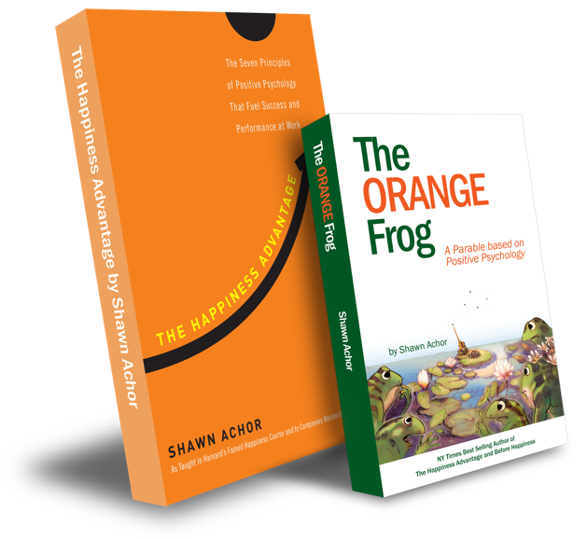
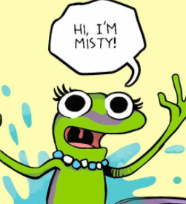
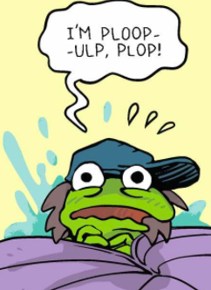
The Happiness Advantage
and
The Orange Frog
Week One
What is The Orange Frog?
By Shawn Achor
Notes:
Ask the participants to have an elbow partner discussion -- “Have you ever had a time when you wanted to be like everyone else? When you wanted to hide your differences to fit in?”.
“I wanted to be like everyone else when __________________”. “I felt different because ______________”.
**Example: “A time when I wanted to hide my differences was when I was asked to speak up at a meeting and was so nervous my voice was shaking. I got several pitied looks. Everyone else who spoke did so with confidence.”

Slide 2
Week One

Slide 3
You should’ve re-read Chapters 1 & 2 of The Orange Frog parable.
Pre-Work
Expectations
Notes:
Have a discussion. Lead the participants to understand that Shawn lets us know this fact because it builds interest and credibility.

Slide 4
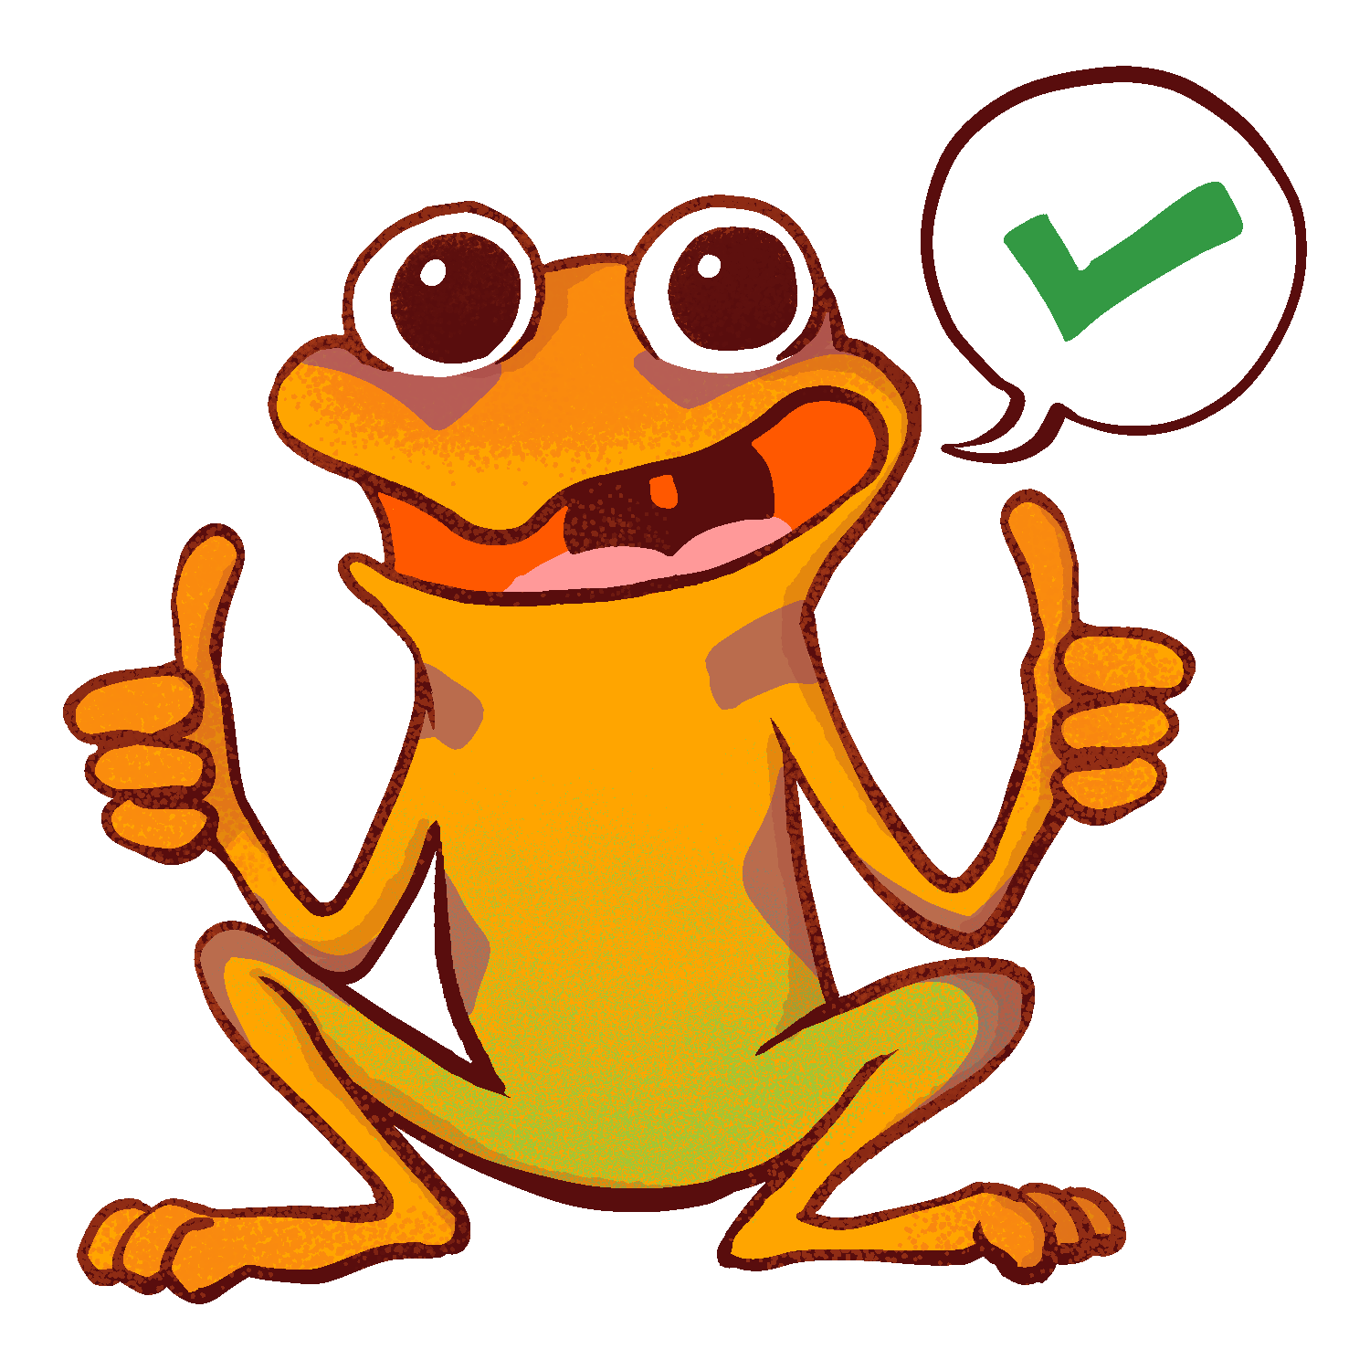
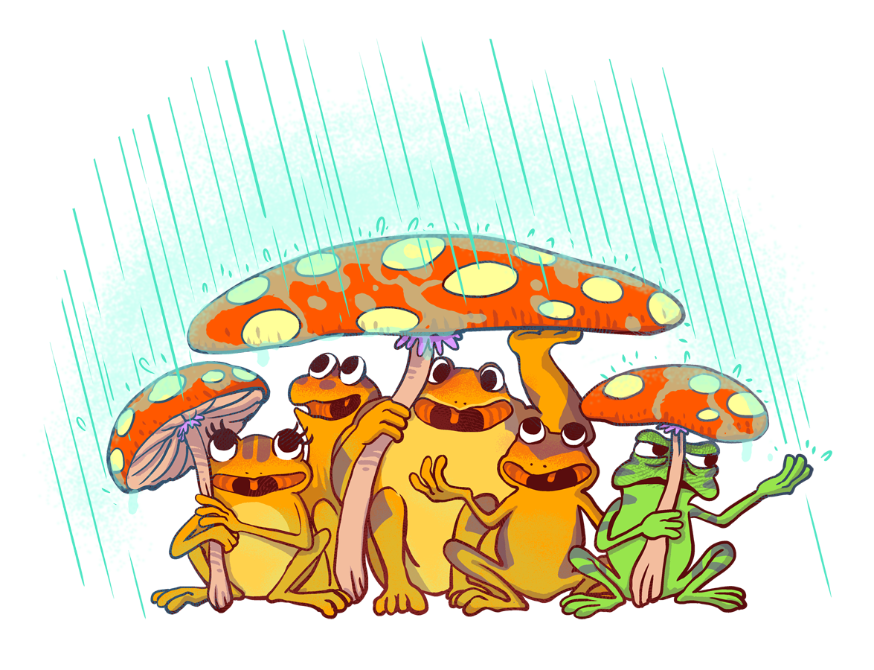
The Orange Frog
P 1
Learning Objective: “Each participant…”
Can read the Orange Frog Parable.
Will discuss the central theme of the Orange Frog and will discover connections for my everyday life.

Slide 5
Essential Concept
Communicate and work productively with others emphasizing collaboration and cultural awareness to produce quality work.
Provide positive encouragement to others.
Relate positively to others.
Understand methods to influence others

Slide 6
Skills Required
Interact positively as a team member.
Cooperate with others in a group setting.
Relationship skills.
Social Awareness
Provide positive encouragement to others.
Relate positively to others.
Understand methods to influence others.

Slide 7
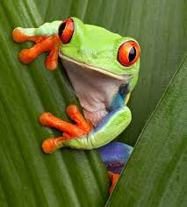
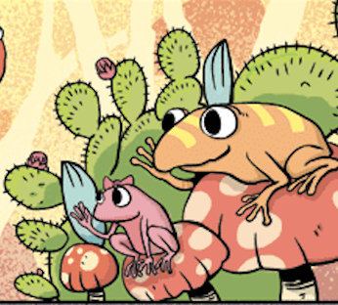
Questions
“Would you say that you are a positive person by nature?”
Or
“Would you say it’s ‘trendy’ to be positive? Or is it more ‘trendy’ to be sarcastic, angsty, and mad?”
Notes:
Facilitate discussion with participants. When they seem to be wrapping it up, tell them, “We are going to read a parable. Can anyone tell me what a parable is?” Take answers
“According to Miriam Webster’s dictionary, a parable is -- a simple story used to illustrate a moral or spiritual lesson. Other examples of parables would be, “The little boy who cried wolf” or “The Three Little Pigs”.
Each of these stories teach a moral or a lesson. The lesson of “The Little Boy Who Cried Wolf” was to be honest. The lesson of The “Three Little Pigs” was to work hard and be patient.
I don’t want to give too much away, but the story of The Orange Frog teaches quite a lesson. We will follow Spark on a journey of self-discovery, self-expression and self-care”.

Slide 8
Introducing The Orange Frog

Slide 9
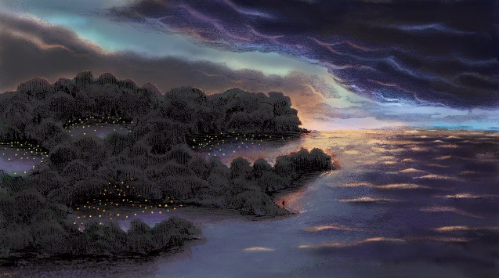
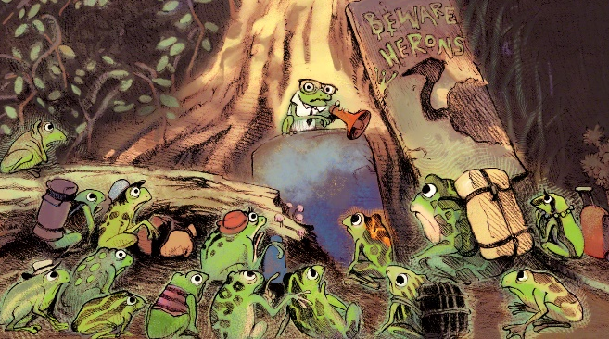
Thoughts for Consideration
In the parable, one of the things we learn, is that the author is in fact a scientist.
He seems quite persistent that we know he’s a scientist and this is the rationale for some of his decision-making.
Why do you think he takes the time to tell us that? And why did Shawn set it up this way?
Notes:
Take discussion. Lead the participants to understand that Shawn lets us know this fact because it builds interest and credibility.

Slide 10
A Glossary of Metaphors
The Thrall | The Deluge | Transition Week
“Changes Perspective & Color. Makes Life less vibrant No Coughing, no Shakes & no Warts | Something we cannot stop. Something we can be ready for. | Coming of Age Trying to “Fit In”
Notes:
Lead the team through a quick discussion of these glossary terms: The Thrall, The Deluge, and Transition Week.
“The author also spends some time telling us about a disease. It’s a disease unlike any other disease. What do you recall him telling us?” Jot down ideas on the board.
The Thrall --
Changes perspective
Changes the color of the frog
Makes life less vibrant, and duller
Doesn’t make you cough
Doesn’t make you grow warts (Although, warts are alluring)
Doesn’t make you shake
The Deluge: We then start to grasp other important events. We hear from the author about the Deluge, and theories centering around it.
Transition Week: We learn that Transition week is much like a holiday to be celebrated. Can anyone connect Transition week to everyday life?” Lead participants to discuss ‘coming of age’ or moving from pre-teen to teenage years.
“It’s easy being green” is by far the truest statement. We learn that Spark is different. Spark isn’t just changed on the outside, but he is changed on the inside too. As readers, we meet three other frogs that were a part of transition week. Misty, Bull and Plop also notice the changes in Spark and ask questions like, “Are you sick?”. Spark seems to be a bit resistant to being different, at first. Why do you think that is?”. Allow discussion to take place.

Slide 11
Connecting this Lesson To Our Work:
What does the Thrall metaphor mean in the “real world” of our work? The Deluge? Transition Week?
How do these metaphors translate into the work we do?
Notes:
Lead them through a discussion on these questions.

Slide 12
Actions
“Have you ever had a time when you wanted to be like everyone else? When you wanted to hide your differences to fit in?”.
“I wanted to be like everyone else when __________________”.
“I felt different because ______________”.
Notes:
Ask the participants to have an elbow partner discussion -- “Have you ever had a time when you wanted to be like everyone else? When you wanted to hide your differences to fit in?”.
“I wanted to be like everyone else when __________________”. “I felt different because ______________”.
**Example: “A time when I wanted to hide my differences was when I was asked to speak up at a meeting and was so nervous my voice was shaking. I got several pitied looks. Everyone else who spoke did so with confidence.”

Slide 13
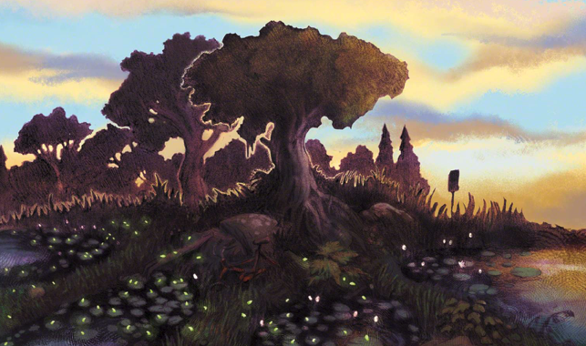
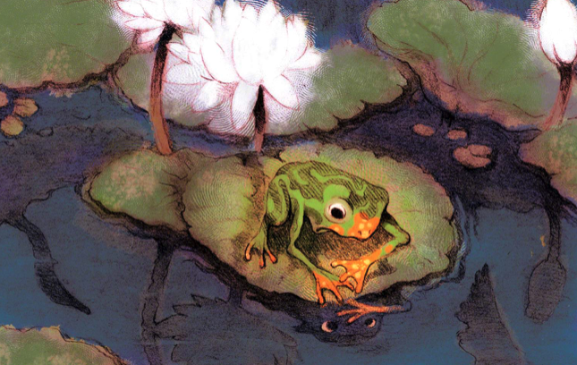
BONUS
Let’s make a connection. What is the Thrall in the “real world”? What can you connect it to? What evidence do you have from the text?
Based on the reaction of others, is being Orange a good thing? Is it “normal”?
What is Spark's immediate solution to his “problem”?
Why do the other frogs seem scared about Spark being Orange? What is the real threat?
Have you ever had to make a choice about being positive?

Slide 14
Weekly To-Dos
Given the lessons that we’ve discussed today, what can you commit to doing immediately that will create a positive impact for people at work this week? Let’s hear your ideas and plans to commit.
Please re-read chapters 3 & 4 before our next session.
Notes:
Ask the participants to have an elbow partner discussion -- “Have you ever had a time when you wanted to be like everyone else? When you wanted to hide your differences to fit in?”.
“I wanted to be like everyone else when __________________”. “I felt different because ______________”.
**Example: “A time when I wanted to hide my differences was when I was asked to speak up at a meeting and was so nervous my voice was shaking. I got several pitied looks. Everyone else who spoke did so with confidence.”

